Slide 1
Computer Graphics 2D Transformations
y
y
x
x
y
x

Slide 2
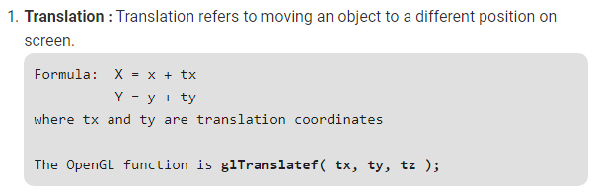
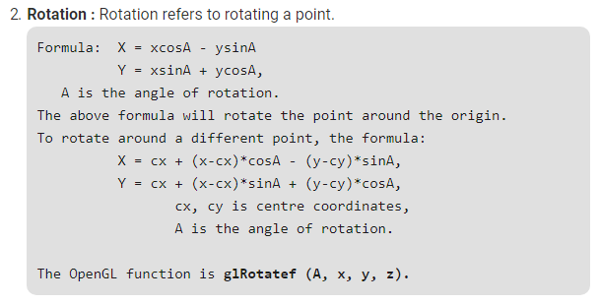
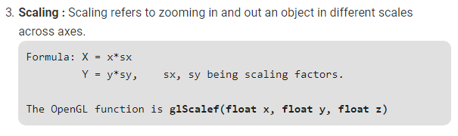

Slide 3
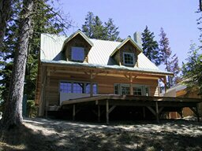
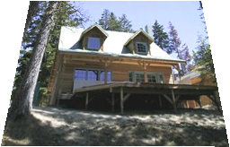
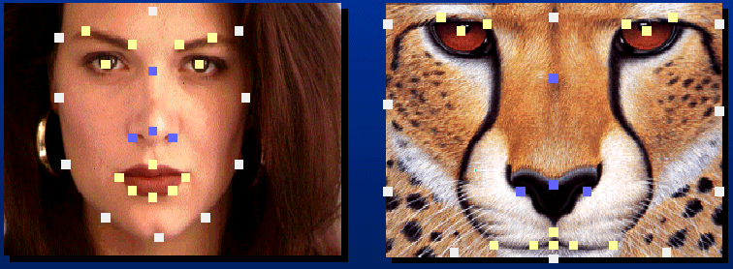
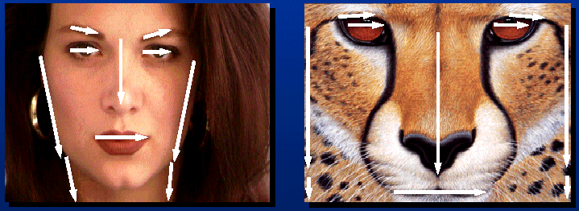
Applications of 2D Transformations
2D geometric transformations
Animation (demo ,demo)
Image warping
Image morphing

Slide 4
2D Transformation
Given a 2D object, transformation is to change the object’s
Position (translation)
Size (scaling)
Orientation (rotation)
Shapes (shear)
Apply a sequence of matrix multiplications to the object vertices

Slide 5
Point Representation
We can use a column vector (a 2x1 matrix) to represent a 2D point x
y
A general form of linear transformation can be written as:
x’ = ax + by + c
OR
y’ = dx + ey + f
X’ a b c x
Y’ = d e f * y
1 0 0 1 1

Slide 6
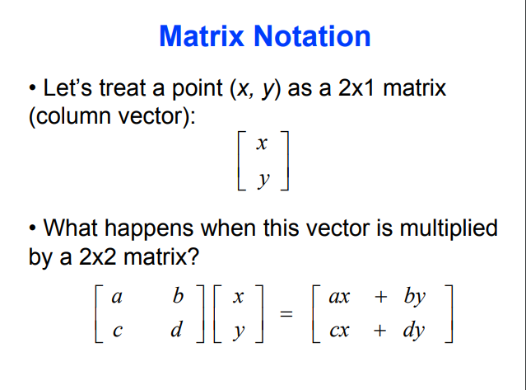

Slide 7
Translation
Re-position a point along a straight line
Given a point (x,y), and the translation distance (tx,ty)
The new point: (x’, y’)
x’ = x + tx
y’ = y + ty
(x’,y’)
ty
(x,y)
tx
OR P’ = P + T where P’ = x’ p = x T = tx
y’ y ty

Slide 8
Translation
How to translate an object with multiple vertices?
Translate individual
vertices

Slide 9
2D Rotation
Default rotation center: Origin (0,0)
y
> 0 : Rotate counter clockwise
θ
o
x
y
< 0 : Rotate clockwise
θ
o
x

Slide 10
2D Rotation
(x,y) -> Rotate about the origin by θ
(x’,y’)
(x’, y’)
θ
(x,y)
r
φ
How to compute (x’, y’) ?

Slide 11
2D Rotation
(x,y) -> Rotate about the origin by θ
y
(x’,y’)
(x’, y’)
θ
(x,y)
r
φ
How to compute (x’, y’) ?
o
x
x = r cos (φ) y = r sin (φ)
x’ = r cos (φ + θ) y’ = r sin (φ + θ)

Slide 12
2D Rotation
(x’,y’)
x = r cos (φ) y = r sin (φ)
x’ = r cos (φ + θ) y = r sin (φ + θ)
(x,y)
θ
r
φ
x’ = r cos (φ + θ)
= r cos(φ) cos(θ) – r sin(φ) sin(θ)
= x cos(θ) – y sin(θ)
y’ = r sin (φ + θ)
= r sin(φ) cos(θ) + r cos(φ)sin(θ)
= y cos(θ) + x sin(θ)

Slide 13
2D Rotation
(x’,y’)
x’ = x cos(θ) – y sin(θ)
y’ = y cos(θ) + x sin(θ)
θ
r
(x,y)
φ
Matrix form?
x’ cos(θ) -sin(θ) x
y’ sin(θ) cos(θ) y
=

Slide 14
2D Rotation
How to rotate an object with multiple vertices?
Rotate individual
Vertices
θ

Slide 15
2D Scaling
Scale: Alter the size of an object by a scaling factor
(Sx, Sy), i.e.
x’ = x . Sx
y’ = y . Sy
x’ Sx 0 x
y’ 0 Sy y
=
(4,4)
(2,2)
Sx = 2, Sy = 2
(2,2)
(1,1)

Slide 16
2D Scaling
(4,4)
(2,2)
Sx = 2, Sy = 2
(2,2)
(1,1)
Not only the object size is changed, it also moved!!
Usually this is an undesirable effect
We will discuss later (soon) how to fix it

Slide 17
Put it all together
Translation:
Rotation:
Scaling:

Slide 18
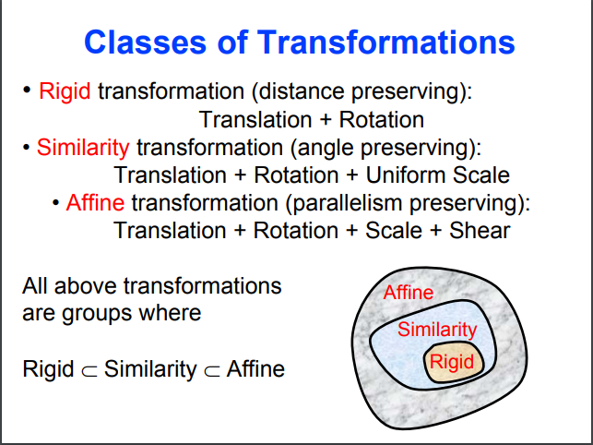

Slide 19
Why Use 3x3 Matrices?
So that we can perform all transformations using matrix/vector multiplications
This allows us to pre-multiply all the matrices together
The point (x,y) needs to be represented as
(x,y,1) -> this is called Homogeneous
coordinates!
How to represent a vector (v_{x},v_{y})?

Slide 20
Why Use 3x3 Matrices?
So that we can perform all transformations using matrix/vector multiplications
This allows us to pre-multiply all the matrices together
The point (x,y) needs to be represented as
(x,y,1) -> this is called Homogeneous
coordinates!
How to represent a vector (v_{x},v_{y})? (v_{x},v_{y},0)

Slide 21
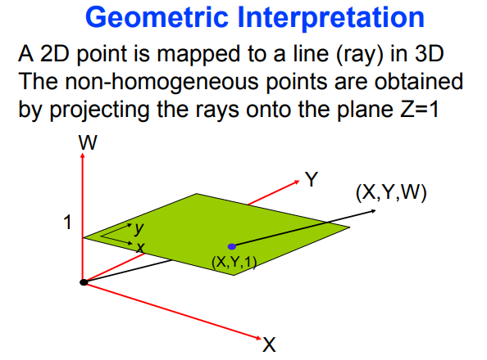

Slide 22
Homogeneous coordinates 1
Uniform representation of translation, rotation, scaling
Uniform representation of points and vectors
Compact representation of sequence of transformations

Slide 23
Homogeneous coordinates 2
Add extra coordinate:
P = (p_{x} , p_{y} , p_{h}) or
x = (x, y, h)
Cartesian coordinates: divide by h
x = (x/h, y/h)
Points: h = 1 (for the time being), vectors: h = 0
The point (x,y) needs to be represented as
(x,y,1) --> this is called Homogeneous
coordinates!

Slide 24
Translation matrix

Slide 25
Rotation matrix

Slide 26
Scaling matrix

Slide 27
Inverse transformations

Slide 28
Combining transformations 1

Slide 29
Combining transformations 2

Slide 30
Combining transformations 3

Slide 31
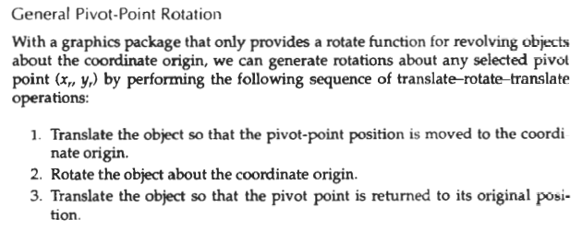
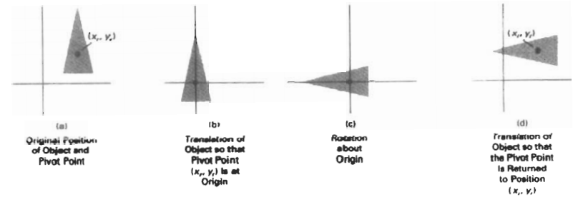

Slide 32
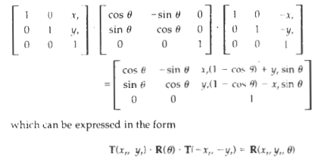

Slide 33
Rotation around a point 1
R
1) 2) 3)

Slide 34
Rotation around a point 2
R
1) 2) 3)

Slide 35
Rotation around point 3
R
1) 2) 3)

Slide 36
Rotation around point 4
R
1) 2) 3)

Slide 37
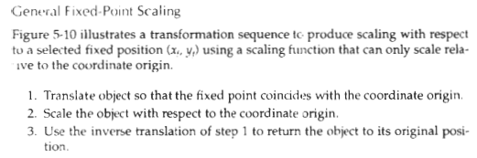
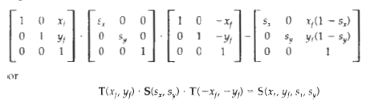

Slide 38
Scaling w.r.t. point 1
F
1) 2) 3)

Slide 39
Scaling w.r.t.point 2
F
1) 2) 3)

Slide 40
Scaling w.r.t.point 3
F
1) 2) 3)

Slide 41
Scale in other directions 1
1) 2) 3)

Slide 42
Scale in other directions 2
1) 2) 3)

Slide 43
Scale in other directions 3
1) 2) 3)

Slide 44
Order of transformations 1
Rotation, translation… Translation, rotation…
y’
y’’
y’’
x’’
x’’
y
y
y’
x’
x’
x
x
Matrix multiplication does not commute.
The order of transformations makes a difference!

Slide 45
Matrices in general
rotation and scaling
translation

Slide 46
Direct construction of matrix
If you know the target frame:
Construct matrix directly.
Define shape in nice local
u,v coordinates, use matrix
transformation to put it
in x,y space.
y
v
u
B
A
T
x

Slide 47
Direct construction of matrix
If you know the target frame:
Construct matrix directly.
y
v
u
B
A
T
x

Slide 48
Rigid body transformation
only rotation
translation
y
u
v
B
A
T
x

Slide 49
Shearing
Y coordinates are unaffected, but x coordinates are translated linearly with y
That is:
y’ = y
x’ = x + y * h
x 1 h 0 x
y = 0 1 0 * y
1 0 0 1 1

Slide 50
Shearing in Y
x 1 0 0 x
y = g 1 0 * y
1 0 0 1 1
Interesting Facts:
A 2D rotation is three shears
Shearing will not change the area of the object
Any 2D shearing can be done by a rotation, followed by a scaling, and followed by a rotation

Slide 51

Reflection about X-axis

Slide 52
Reflection about X-axis
x 1 0 0 x
y = 0 -1 0 * y
1 0 0 1 1

Slide 53
Reflection about Y-axis

Slide 54
Reflection about Y-axis
x -1 0 0 x
y = 0 1 0 * y
1 0 0 1 1

Slide 55

What’s the Transformation Matrix?

Slide 56
What’s the Transformation Matrix?
x -1 0 0 x
y = 0 -1 0 * y
1 0 0 1 1

Slide 57
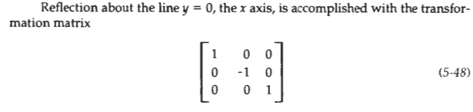
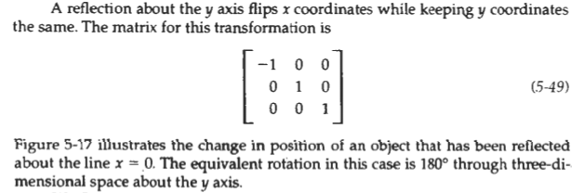
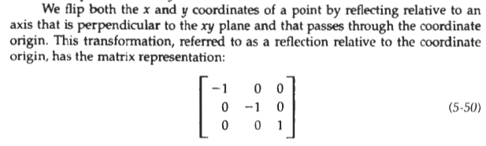

Slide 58
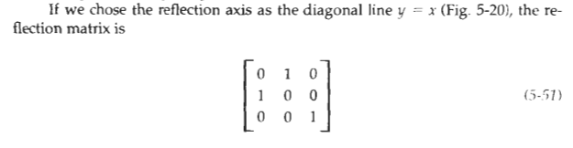
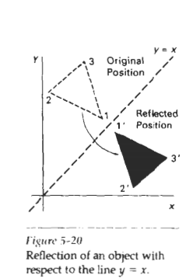

Slide 59
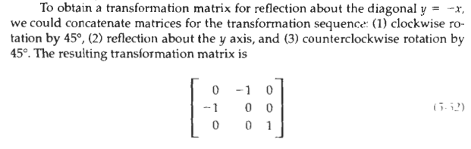
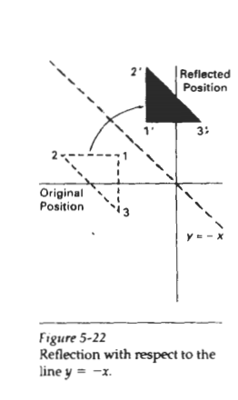

Slide 60
Reflection about An Arbitrary Line

Slide 61
Reflection about An Arbitrary Line
Rotate the object to align the reflection vector with x axis:
61

Slide 62
Reflection about An Arbitrary Line
Rotate the object to align the reflection vector with x axis:
Reflect the object
62

Slide 63
Reflection about An Arbitrary Line
Rotate the object to align the reflection vector with x axis:
Reflect the object
Rotate the object back:
63

Slide 64
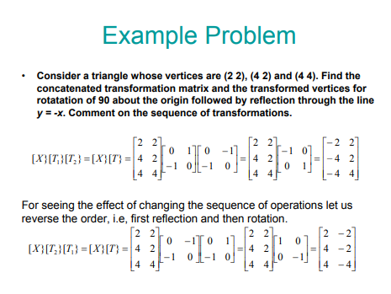

Slide 65
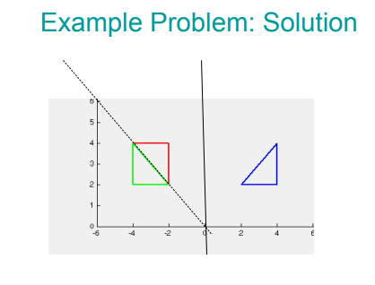

Slide 66
Composing Transformation
Composing Transformation – the process of applying several transformation in succession to form one overall transformation
If we apply transforming a point P using M1 matrix first, and then transforming using M2, and then M3, then we have:
(M3 x (M2 x (M1 x P )))

Slide 67
Composing Transformation
Composing Transformation – the process of applying several transformation in succession to form one overall transformation
If we apply transforming a point P using M1 matrix first, and then transforming using M2, and then M3, then we have:
(M3 x (M2 x (M1 x P ))) = M3 x M2 x M1 x P
(pre-multiply)
M
67

Slide 68
Arbitrary Rotation Center
(px,py)
x’ 1 0 px cos(θ) -sin(θ) 0 1 0 -px x
y’ = 0 1 py sin(θ) cos(θ) 0 0 1 -py y
1 0 0 1 0 0 1 0 0 1 1
68

Slide 69
Arbitrary Rotation Center
(px,py)
x’ 1 0 px cos(θ) -sin(θ) 0 1 0 -px x
y’ = 0 1 py sin(θ) cos(θ) 0 0 1 -py y
1 0 0 1 0 0 1 0 0 1 1
M3
M2
M1
M= M3*M2*M1
69

Slide 70
Composing Transformation
Matrix multiplication is associative
M3 x M2 x M1 = (M3 x M2) x M1 = M3 x (M2 x M1)
Transformation products may not be commutative A x B != B x A

Slide 71
Transformation Order Matters!
Example: rotation and translation are not commutative
Translate (5,0) and then Rotate 60 degree
OR
Rotate 60 degree and then translate (5,0)??
Rotate and then translate !!

Slide 72
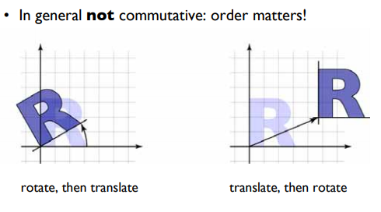
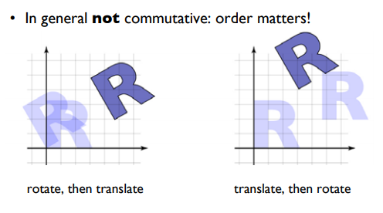
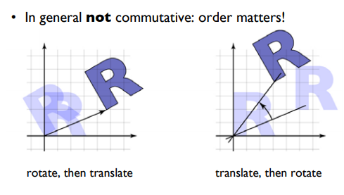

Slide 73
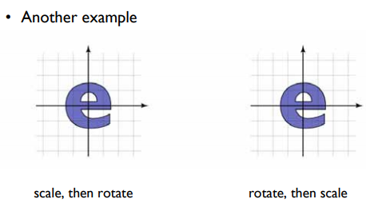
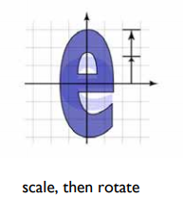
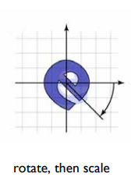
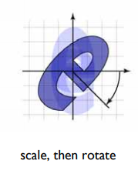
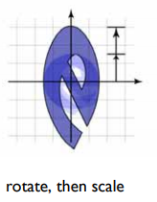

Slide 74
Composing Transformation
Matrix multiplication is associative
M3 x M2 x M1 = (M3 x M2) x M1 = M3 x (M2 x M1)
Transformation products may not be commutative A x B != B x A
Some cases where A x B = B x A
A B
translation translation
scaling scaling
rotation rotation
74

Slide 75
Thank You

Slide 76
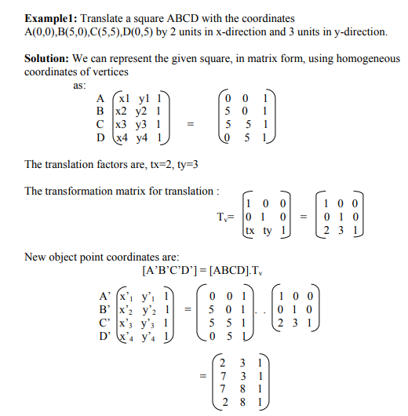


Slide 77
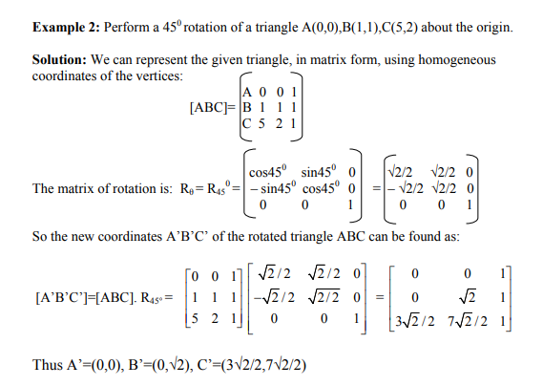

Slide 78
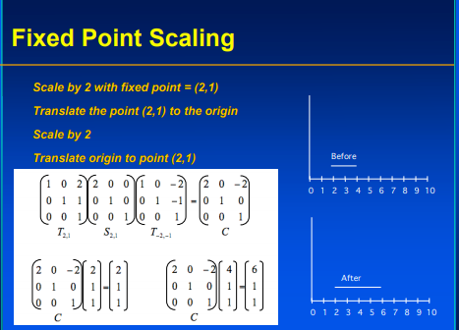
EXAMPLE 3

Slide 79
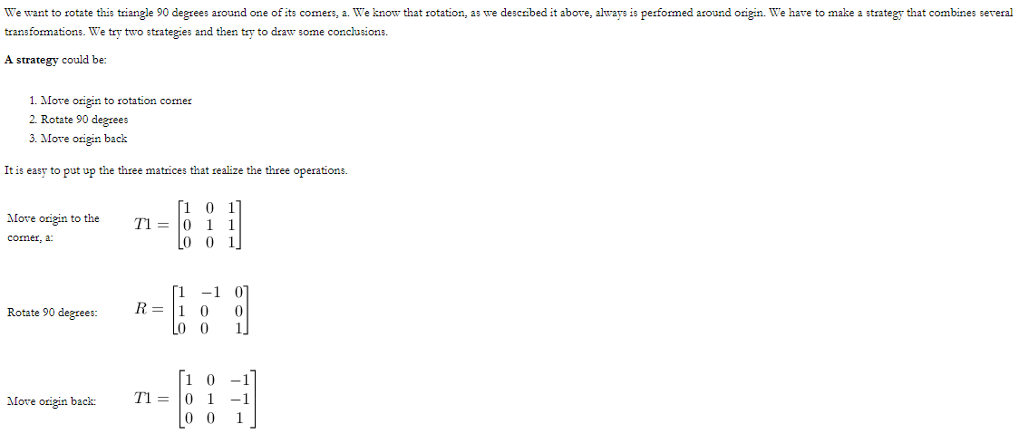
EXAMPLE 4

Slide 80
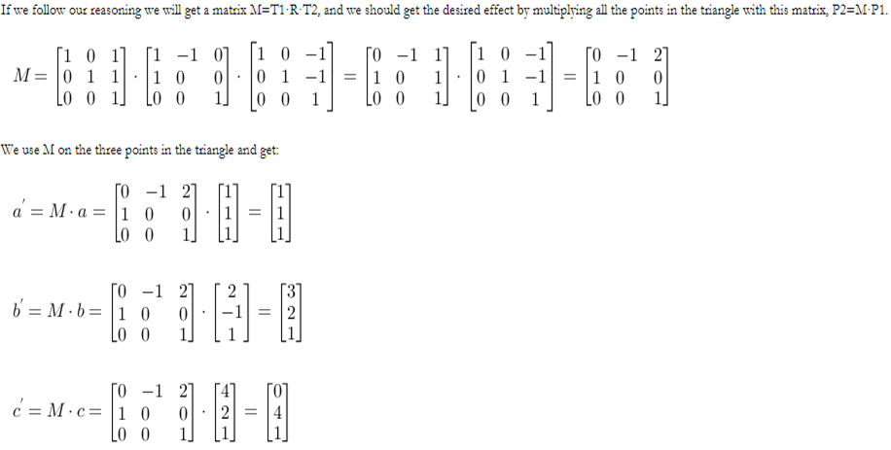
All Coordinates can be written together in matrix form also.
1 | 2 | 0
1 | -1 | 4
1 | 1 | 1

Slide 81
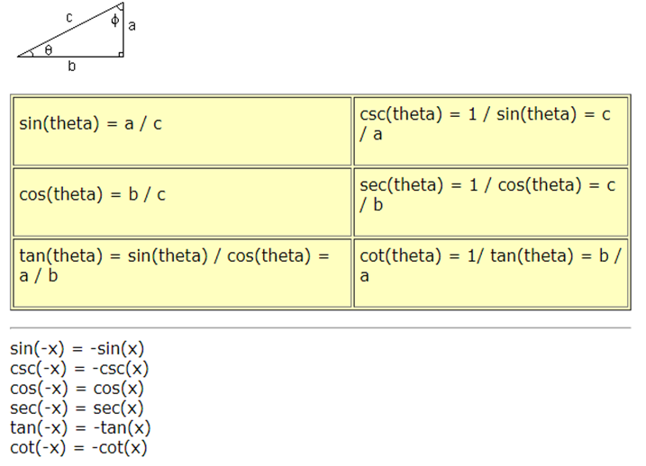
Trigonometric Identities

Slide 82
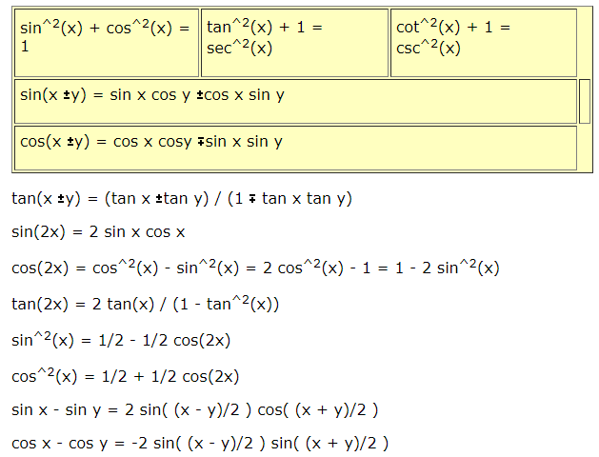

Slide 83
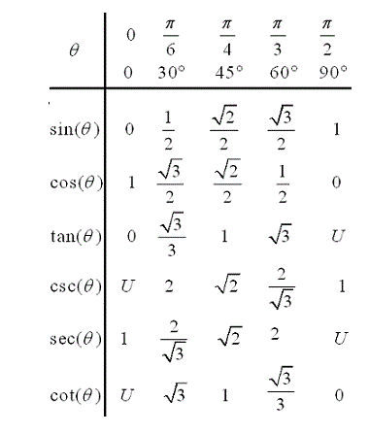
Trigonometric table for common angles

